Slide 1


STATISTICS
Session 8: Classification & Prediction

Slide 2
Explanation vs Prediction
Explain
Predict
The goal is to understand relationships between variables and uncover why something happens.
  Example: Using regression to see how difference in ratings, training hours, coaching experience, etc., influence score margin.
  Focus: coefficients, significance tests, causal or correlational interpretations.
The goal is to forecast outcomes as accurately as possible, often without needing to interpret the underlying relationships.
  Example: Using a machine learning model to predict exam scores for future students.
  Focus: accuracy metrics (e.g., RMSE, accuracy, precision/recall), out-of-sample performance.

Slide 3

Recap: Multiple Regression
Last time we looked at building regression models when the outcome was numeric
For example, we could look at modelling:
  Income ($)
  Exam score (points)
  Height (cm)
  Return on investment (ROI in points)
The key is: the outcome (y) was numeric and measured on a continuous scale
$$y=b_{0}+b_{1}x_{1}+b_{2}x_{2}+…b_{k}x_{k}+ε$$

Slide 4
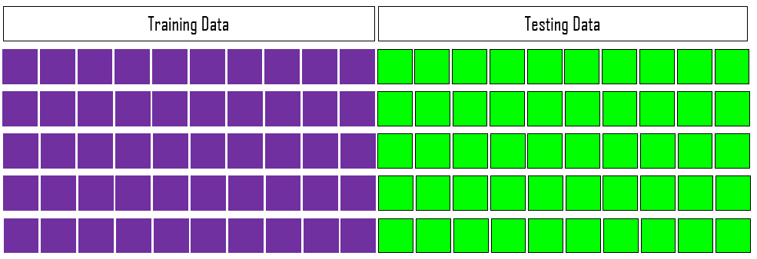
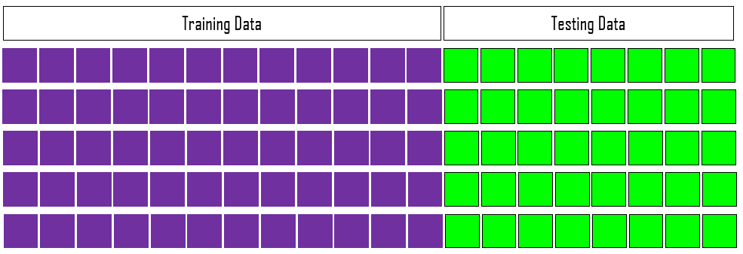
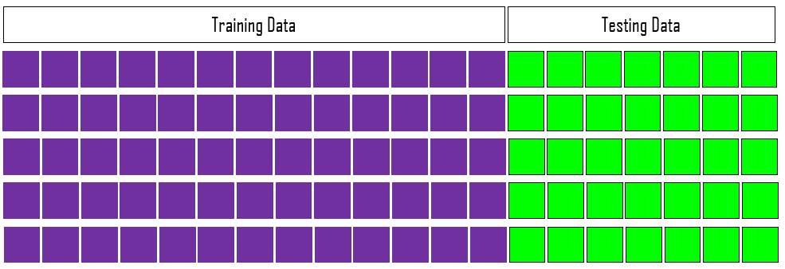
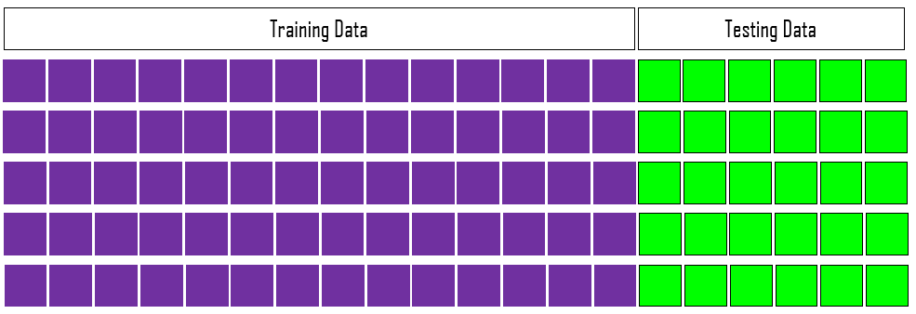
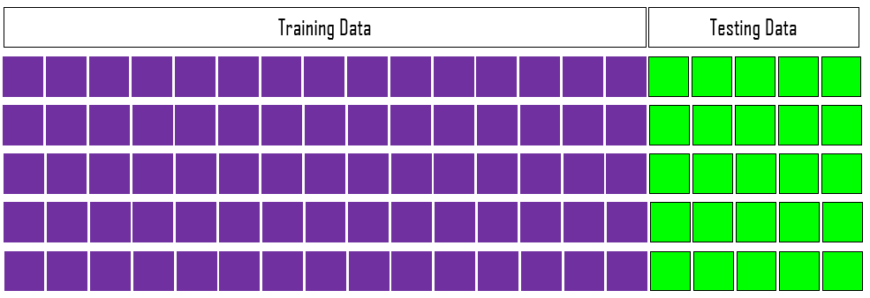

Training and Testing Data Sets
Training set: used to build / fit the model. The model ‘learns’ the relationship between predictors (X) and the outcome (Y).
Testing set: Used to evaluate the model’s performance on unseen data, checking if it generalises beyond the training data.
There is no universally correct training/test split.
  A larger training set gives the model more observations to learn from.
50%
50%
60%
40%
65%
35%
70%
30%
75%
25%
80%
20%

Slide 5
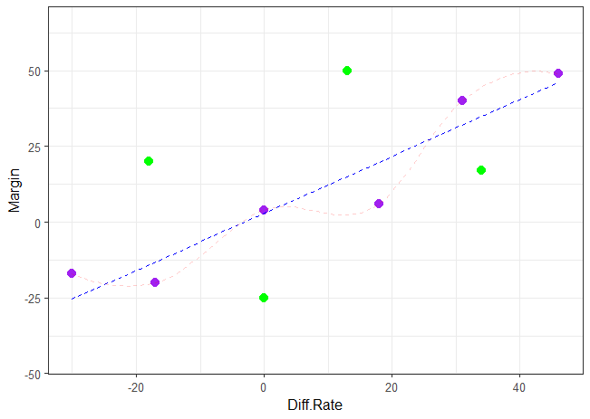
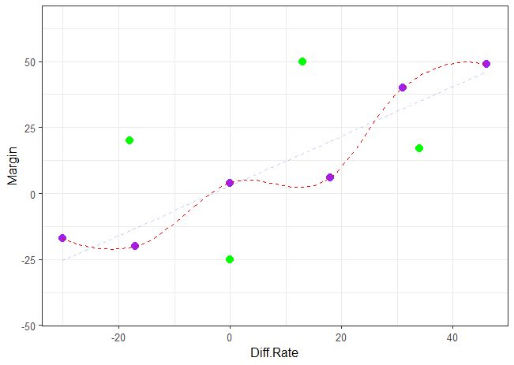
Comparing Models
Y
Model 1
X
-17
-30
0
18
31
46
Y
-20
-17
4
6
40
49
X
Y
Model 2
X

Slide 6
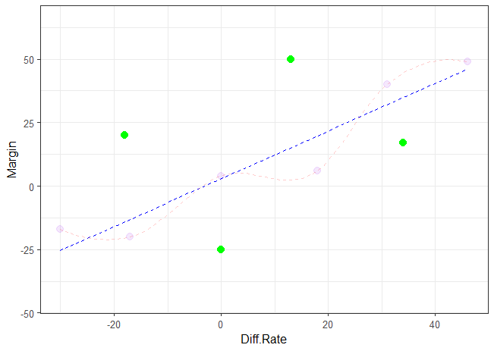
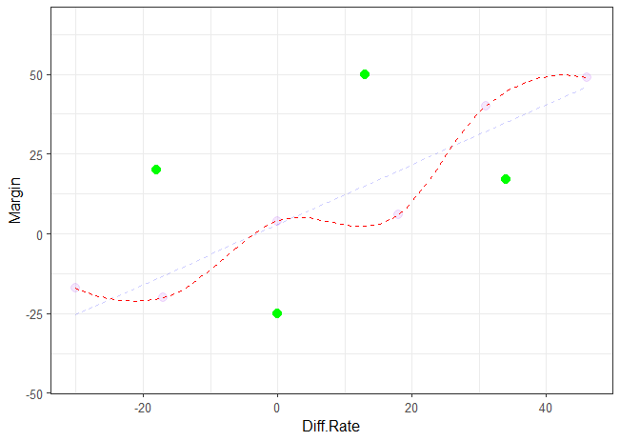
Comparing Models
New (Test) data is used to evaluate the models – we want the model that has less error

Slide 7
Regression vs Classification
Suppose that instead of modelling a continuous outcome (-∞, +∞), we wanted to examine a binary outcome (0, 1).
We cannot use linear regression because the model will make predictions less than 0 and greater than 1.
Therefore we will need a different type of model – one that fits a binary (0, 1) outcome.
Sometimes, these types of models are called ‘classification’ models.
Continuous
-17
-30
0
18
31
46
10
5
20
Binary
0
0
1
1
0
1
0
1
1

Slide 8
Regression vs Classification
Suppose that instead of modelling a continuous outcome (-∞, +∞), we wanted to examine a binary outcome (0, 1).
We cannot use linear regression because the model will make predictions less than 0 and greater than 1.
Therefore we will need a different type of model – one that fits a binary (0, 1) outcome.
Sometimes, these types of models are called ‘classification’ models.
Continuous
-17
-30
0
18
31
46
10
5
20
Binary
0
0
1
1
0
1
0
1
1

Slide 9
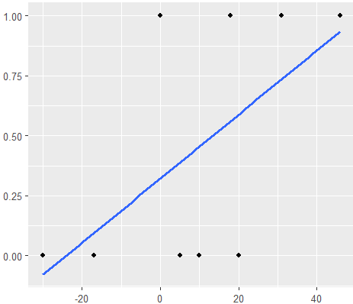
Linear Probability Model (LPM)
The linear probability model (LPM) uses linear regression to model a binary outcome, coded as 0 or 1.
Predicted values represent the probability that the outcome equals 1.
Each coefficient describes the change in probability for a one-unit increase in a predictor, holding other predictors constant.
A key limitation is that predicted probabilities can fall below 0 or above 1.

Slide 10
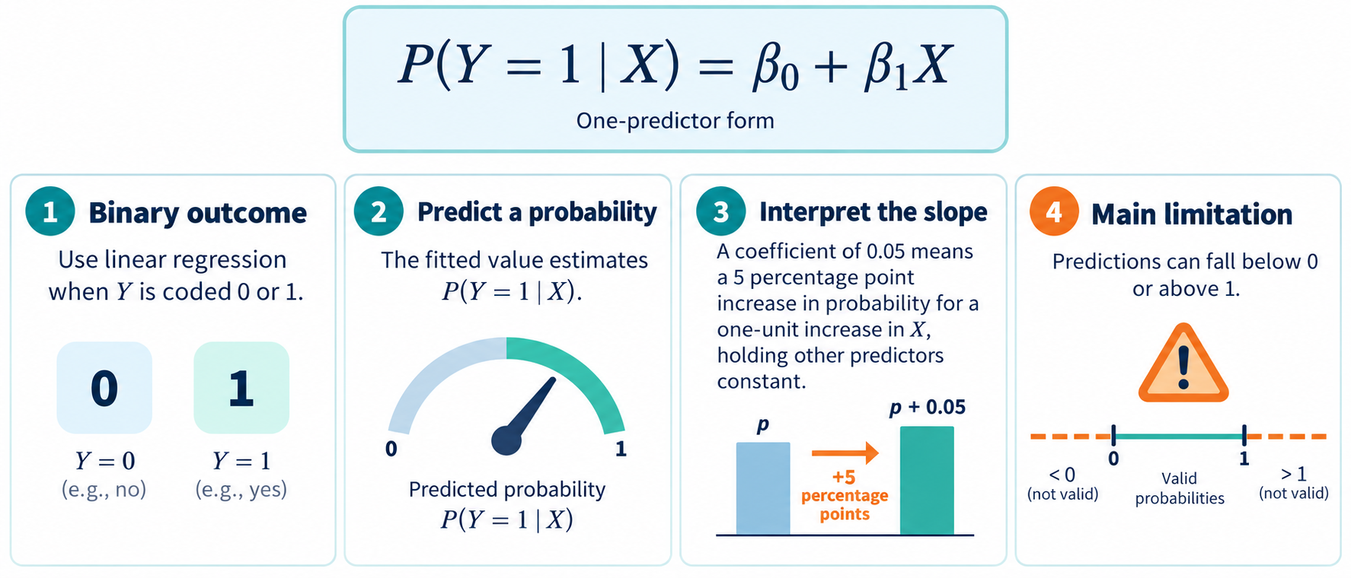
Linear Probability Model (LPM)

Slide 11
Linear Probability Model (LPM)
X | Y
-17 | 0
-30 | 0
0 | 1
18 | 1
31 | 1
46 | 1
10 | 0
5 | 0
20 | 0
Prediction
0.321 + 0.013(-17) = 0.094
0.321 + 0.013(-30) = -0.080
0.321 + 0.013(0) = 0.321
0.321 + 0.013(18) = 0.562
0.321 + 0.013(31) = 0.735
0.321 + 0.013(46) = 0.936
0.321 + 0.013(10) = 0.455
0.321 + 0.013(5) = 0.388
0.321 + 0.013(20) = 0.588
Y = 0.321 + 0.013(X)

Slide 12
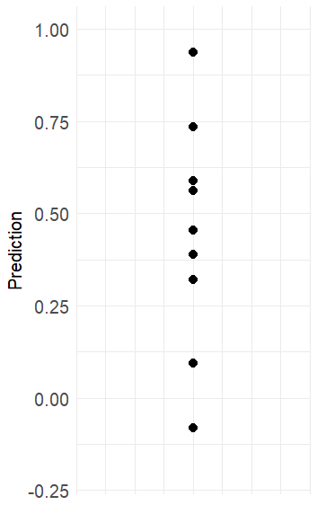
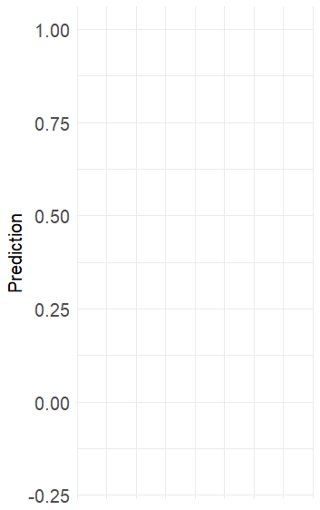
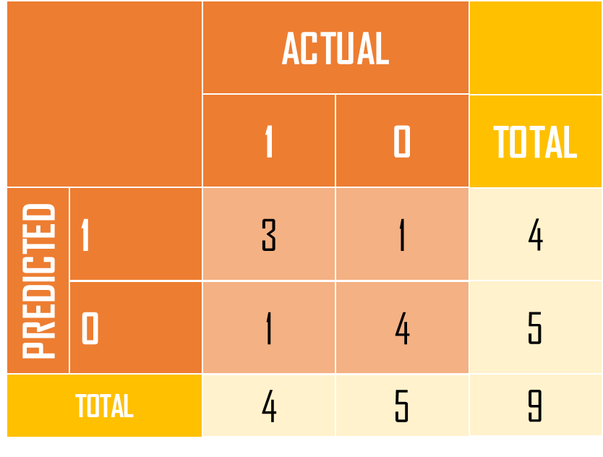
Thresholds & Classification
Y = 0.321 + 0.013(X)
X | Y | Pred
-17 | 0 | .094
-30 | 0 | -.080
0 | 1 | .321
18 | 1 | .562
31 | 1 | .735
46 | 1 | .936
10 | 0 | .455
5 | 0 | .388
20 | 0 | .588
Class
0
0
0
1
1
1
0
0
1
.936
.735
.588
.562
threshold
.455
.388
.321
.094
-.080

Slide 13
Classification Errors
ACTUAL
ACTUAL
1
0
1
0
1
3
1
1
True Positive
False Positive
PREDICTED
PREDICTED
0
1
4
0
False Negative
True Negative

Slide 14












Comparing Models - Classification Errors
ACTUAL
ACTUAL
Model 1
Model 2
1
0
1
0
1
242
47
1
239
40
PREDICTED
PREDICTED
0
51
210
0
32
141
False Positive Rate
(Type I Error)
$$=\frac{FP}{FP+TN}$$
False Negative Rate
(Type II Error)
$$=\frac{FN}{FN+TP}$$
False Positive Rate
(Type I Error)
$$=\frac{FP}{FP+TN}$$
False Negative Rate
(Type II Error)
$$=\frac{FN}{FN+TP}$$
$$=\frac{47}{47+210}$$
$$=\frac{51}{51+242}$$
$$=\frac{40}{40+141}$$
$$=\frac{32}{32+239}$$
$$=0.183$$
$$=0.174$$
$$=0.221$$
$$=0. 118$$

Slide 15






Comparing Models - Classification Errors
ACTUAL
ACTUAL
Model 1
Model 2
1
0
1
0
1
242
47
1
239
40
PREDICTED
PREDICTED
0
51
210
0
32
141
Overall Accuracy
$$=\frac{TP+TN}{TP+TN+FP+FN}$$
Overall Accuracy
$$=\frac{TP+TN}{TP+TN+FP+FN}$$
$$=\frac{242+210}{242+210+51+47}$$
$$=\frac{239+141}{239+141+32+40}$$
$$=0.823$$
$$=0.841$$

Slide 16
Using Different Thresholds
ACTUAL
Using Threshold 0.25
X | Y | Pred
-17 | 0 | .094
-30 | 0 | -.080
0 | 1 | .321
18 | 1 | .562
31 | 1 | .735
46 | 1 | .936
10 | 0 | .455
5 | 0 | .388
20 | 0 | .588
Class
0
0
1
1
1
1
1
1
1
.936
.735
1
0
.588
.562
.455
1
4
3
.388
.321
threshold
PREDICTED
0
0
2
.094
-.080

Slide 17
Using Different Thresholds
ACTUAL
Using Threshold 0.75
X | Y | Pred
-17 | 0 | .094
-30 | 0 | -.080
0 | 1 | .321
18 | 1 | .562
31 | 1 | .735
46 | 1 | .936
10 | 0 | .455
5 | 0 | .388
20 | 0 | .588
Class
0
0
0
0
0
1
0
0
0
.936
.735
threshold
1
0
.588
.562
.455
1
1
0
.388
.321
PREDICTED
0
4
5
.094
-.080

Slide 18


















Using Different Thresholds
ACTUAL
ACTUAL
ACTUAL
Using Threshold 0.25
Using Threshold 0.50
Using Threshold 0.75
1
0
1
0
1
0
1
4
3
1
3
1
1
1
0
PREDICTED
PREDICTED
PREDICTED
0
0
2
0
1
4
0
4
5
$$FPR=\frac{FP}{FP+TN}$$
$$FNR=\frac{FN}{FN+TP}$$
$$FPR=\frac{FP}{FP+TN}$$
$$FNR=\frac{FN}{FN+TP}$$
$$FPR=\frac{FP}{FP+TN}$$
$$FNR=\frac{FN}{FN+TP}$$
$$=\frac{3}{3+2}$$
$$=\frac{0}{0+4}$$
$$=\frac{1}{1+4}$$
$$=\frac{1}{1+3}$$
$$=\frac{0}{0+5}$$
$$=\frac{4}{4+1}$$
$$=0.60$$
$$=0.00$$
$$=0.20$$
$$=0.25$$
$$=0.00$$
$$=0.80$$

